Slide 1
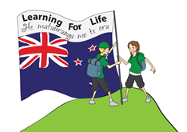

Word Rumble
Let’s get ready to rumble!!!
Set L

Slide 2
achieve

Slide 3
anyhow

Slide 4
anyone

Slide 5
anything

Slide 6
anyway

Slide 7
anywhere

Slide 8
autumn

Slide 9
born

Slide 10
borrow

Slide 11
bulb

Slide 12
burglar

Slide 13
calf

Slide 14
calves

Slide 15
capital

Slide 16

castle

Slide 17
check

Slide 18
cheque

Slide 19
choose

Slide 20
choosing

Slide 21
dairy

Slide 22
damage

Slide 23
dangerous

Slide 24
daughter

Slide 25
daylight

Slide 26
early

Slide 27
earlier

Slide 28
familiar

Slide 29
famous

Slide 30
fantastic

Slide 31
glove

Slide 32
gradually

Slide 33
gymnastics

Slide 34
hangi

Slide 35
happiness

Slide 36
hasn’t

Slide 37
innocent

Slide 38
island

Slide 39
presents

Slide 40
roads

Slide 41
yacht

