Slide 1
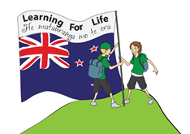

Word Rumble
Let’s get ready to rumble!!!
Set K

Slide 2
actually

Slide 3
activity

Slide 4
address

Slide 5
adventure

Slide 6
arrange

Slide 7
arrival

Slide 8
beaten

Slide 9
beautiful

Slide 10
berries

Slide 11
beside

Slide 12
blood

Slide 13
blow

Slide 14
blown

Slide 15
body

Slide 16

bodies

Slide 17
boil

Slide 18
breath

Slide 19
breathe

Slide 20
broken

Slide 21
calendar

Slide 22
camera

Slide 23
care

Slide 24
careful

Slide 25
careless

Slide 26
ground

Slide 27
guard

Slide 28
healthy

Slide 29
height

Slide 30
hospital

Slide 31
ordinary

Slide 32
opposite

Slide 33
parents

Slide 34
picked

Slide 35
question

Slide 36
quietly

Slide 37
quite

Slide 38
remember

Slide 39
reply

Slide 40
rescue

Slide 41
science

